Slide 1
Celadon City
Team Absentee: Andrew Paek, Yaoxian Qu,
Douglas Schmieder, Nick Smith

Slide 2
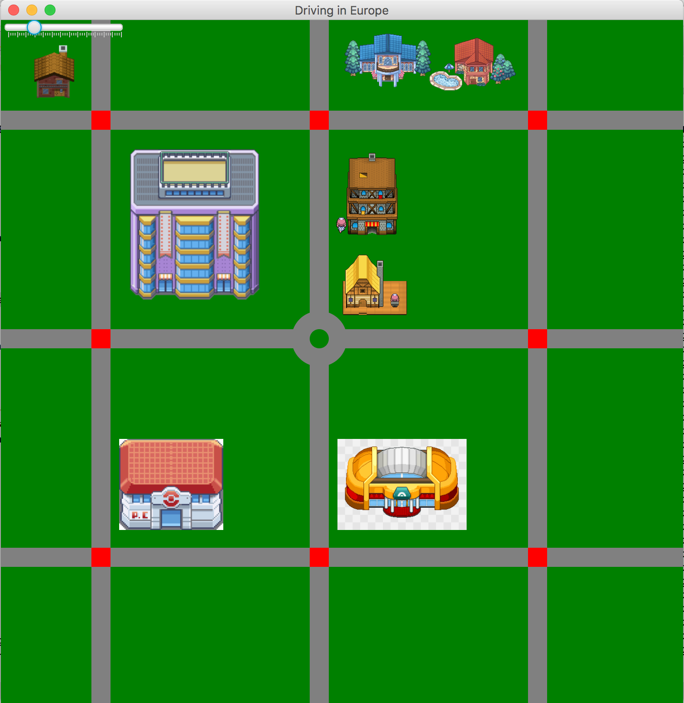
Layout Map
(Singleton Pattern)

Slide 3
Driving Through Streets
Road class contains a queue of current vehicles on the road
When vehicles want to enter the road, check if the road is full, enter if not full.
Pop the vehicle from the road queue when the vehicle leaves the edge of the road.

Slide 4
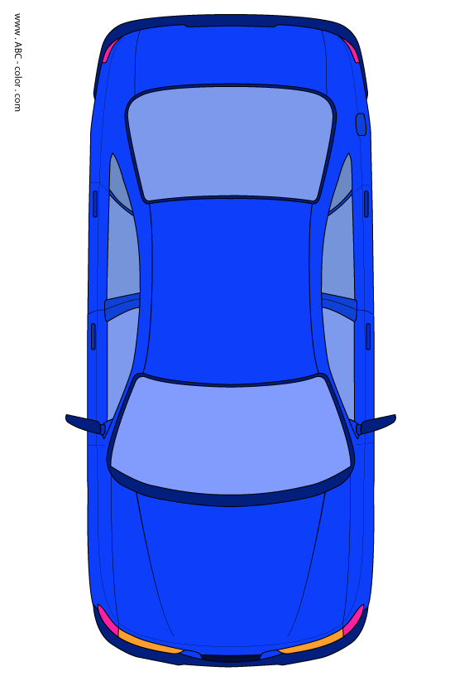
Vehicle Behavior
Utilizes Factory Pattern for vehicle generation
Collision Avoidance
Observer Pattern

Slide 5
Traffic Rules
Stop lights:
-Green (continue), Yellow (stop), Red (stop)
Intersection:
-Only one car can be in the intersection at a time
-Car enters the intersection according to the stoplight at the intersection
Roundabout:
-Only one car can be in the roundabout at a time
-The same as intersection other than hard-coded animations which allow car to navigate to different exit points.

Slide 6
Simulation
Timers that handle different functionality throughout the simulation
-Car generation
-Road Exits
-Lights
Handles all initialization of the program

Slide 7
WE DID IT

